Slide 1

Nextion editor
The tft display’s own interface developing software

Slide 2
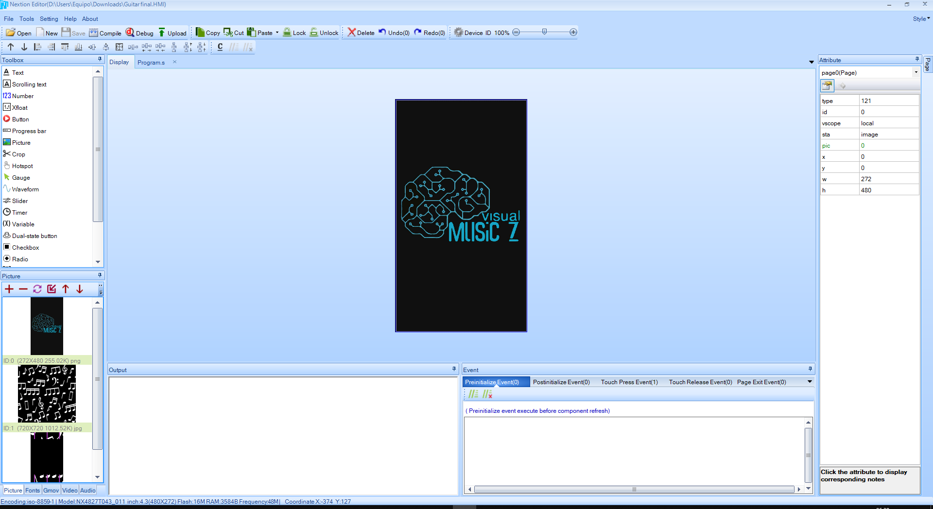
Main menu

Slide 3
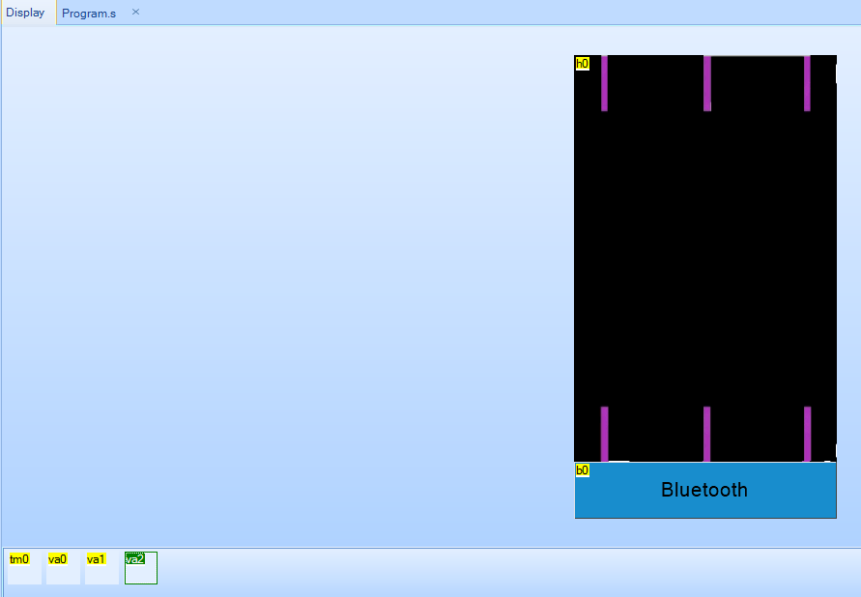
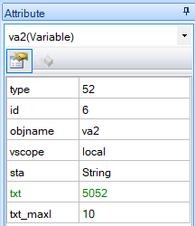
TOOLBOX
Here you can pick different tools to add in our display screen/page.
In this case we used text, pictures, an slider, a push button, a timer and 3 string type variables.

Slide 4
PICTURES
In the pictures section we included the backgrounds that we would be using for the two screens.

Slide 5
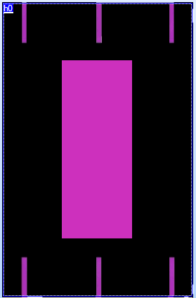
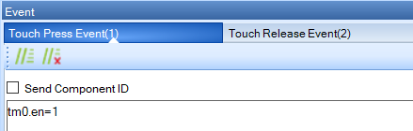
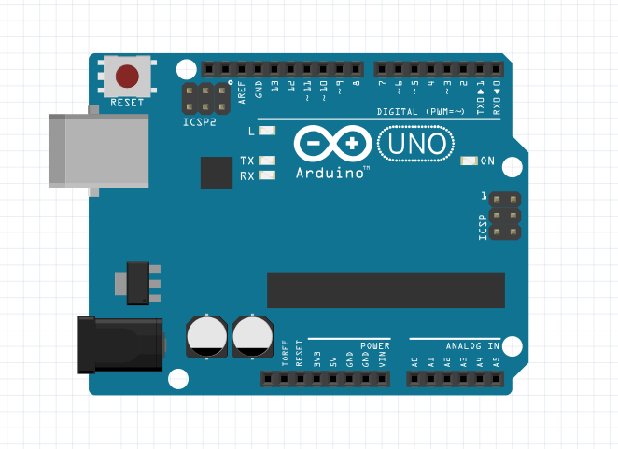

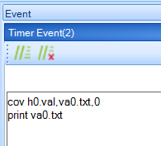
CODE
The code part is really short and simple, most of it is related to the timer, so this is the explanation: whenever the slider is touch pressed, the timer starts (tm0.en=1), and every 100 milliseconds (tim=100), the value of the slider (h0.val) is saved as text (va0.txt) and then printed/sent to the Arduino (print va0.txt) via serial communication to play a note.

Slide 6
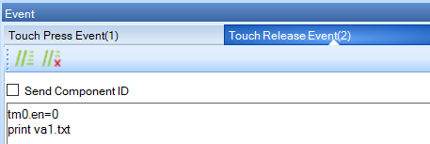
CODE
Now, when the slider is touch released, it stops the timer (tm0.en=0) and sends text to the Arduino (print va1.txt) to let it know the note has been stopped.

Slide 7

MORE INFO AT: https://nextion.tech/nextion-editor/

